Slide 1
I THINK YOU WOULD LIKE THIS …….

Slide 2


HAPPY BIRTHDAY GOLI
MAY GOD BLESS YOU

Slide 3

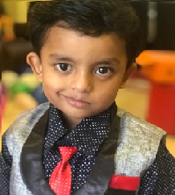
This
is
your
day
enjoy

Slide 4
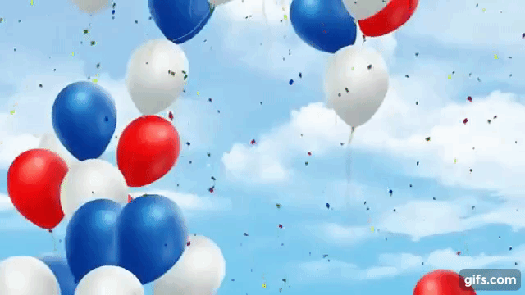
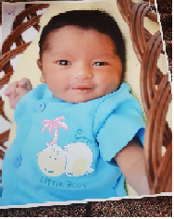
YOU ARE MY CUTE LITTLE BROTHER

Slide 5
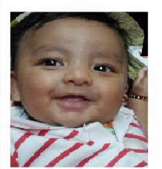

YOU ARE MY BEST BROTHER IN THE WORLD

Slide 6


Slide 7

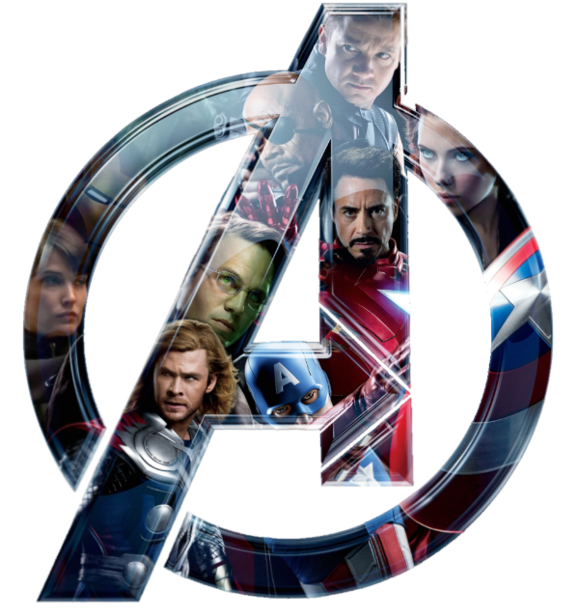
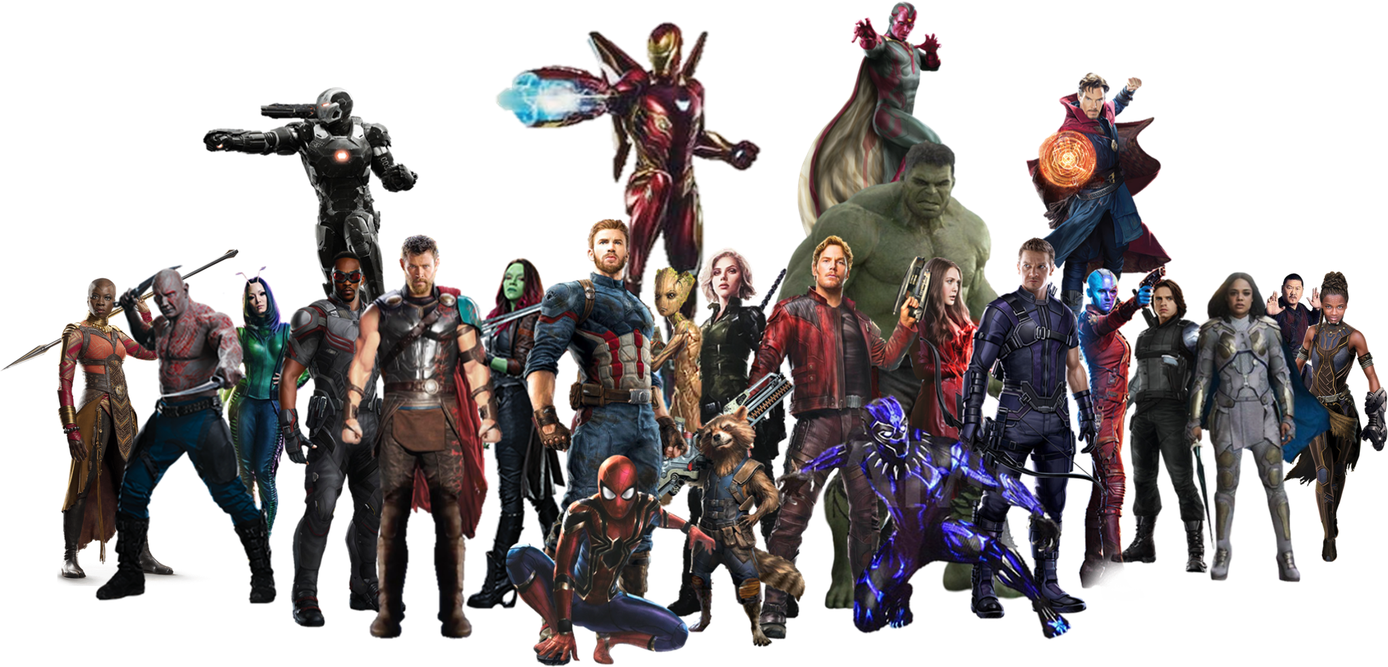
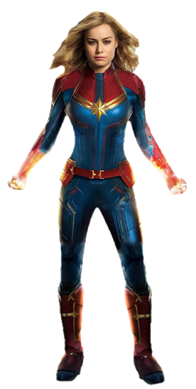
YOU ARE MY SUPER HERO

Slide 8


